Slide 1

Implementation of the SAHI on YOLOv8 model
07/07/2023

Slide 2
Agenda
YOLOv8 implemented on an image
YOLOv8 + SAHI on an image
YOLOv8 + SAHI tested on large objects
Containerization with Docker
Docker Hub
YOLO-NAS

Slide 3

YOLOv8
Yolov8 implemented on an image

Slide 4
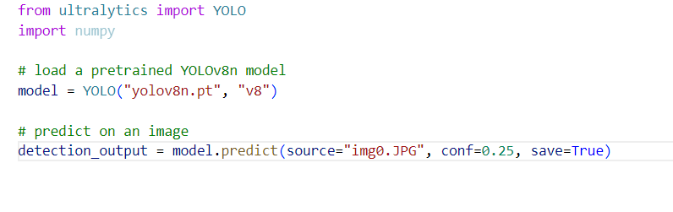

Slide 5
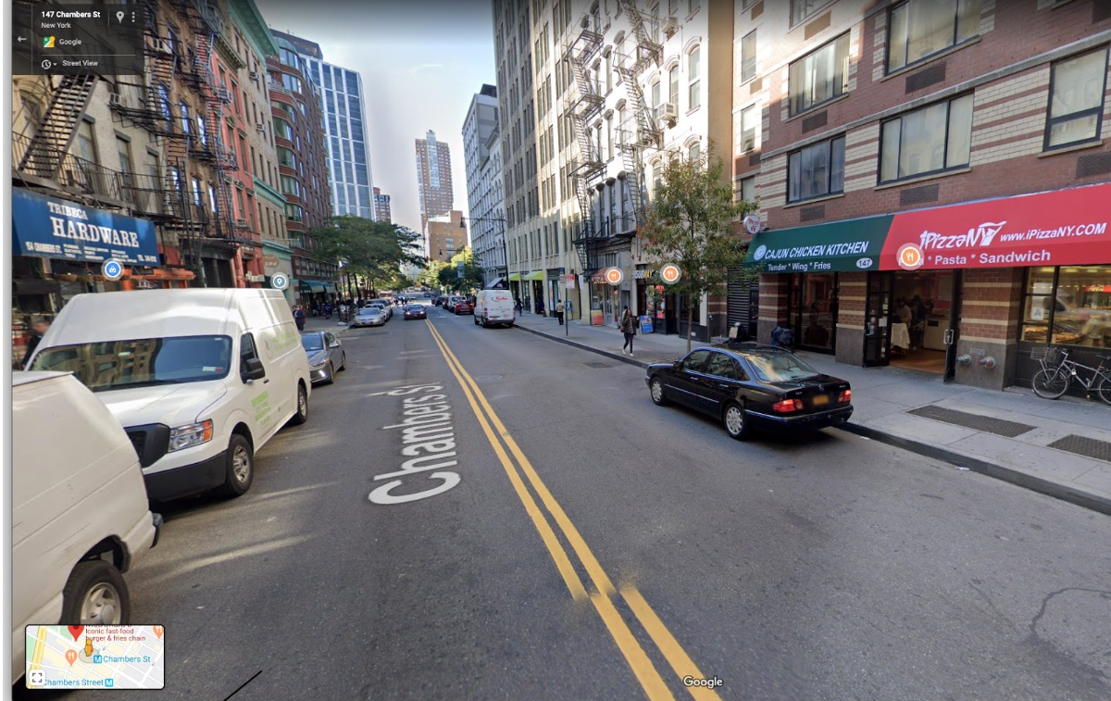
Input Image

Slide 6
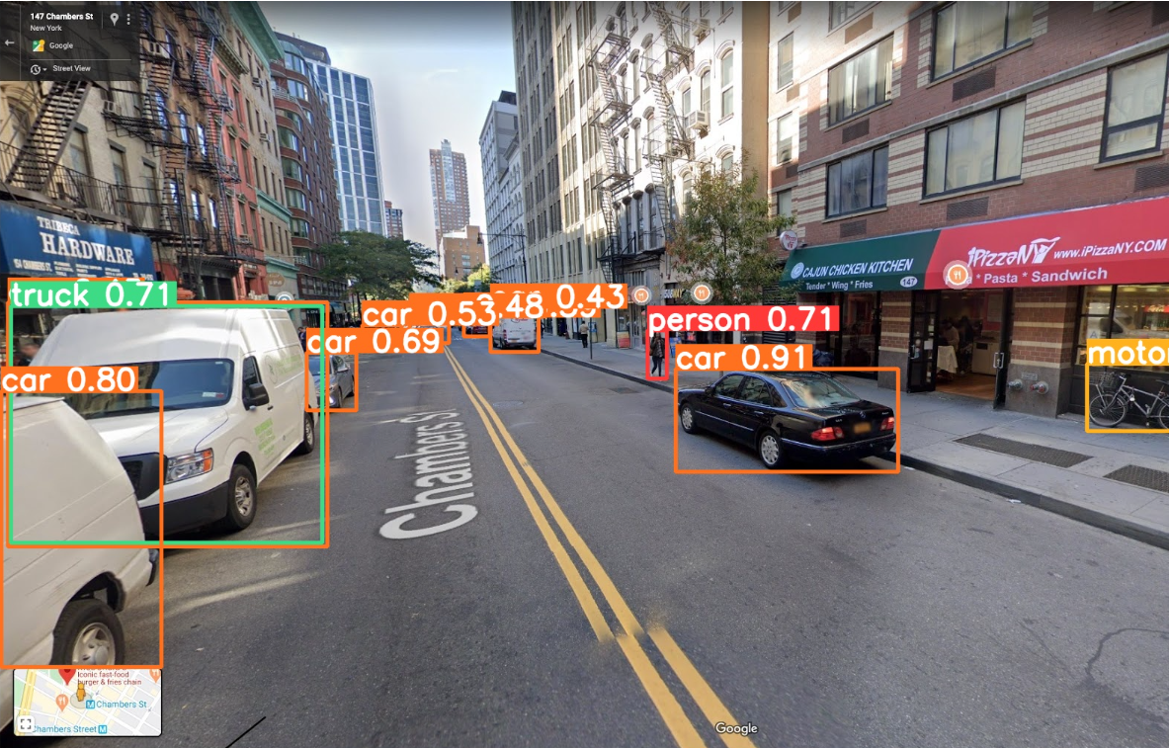
Output Image
Notice that Yolov8 by itself fails to detect small objects in this example : enters SAHI .

Slide 7
YOLOv8 + SAHI
implemented on an image

Slide 8
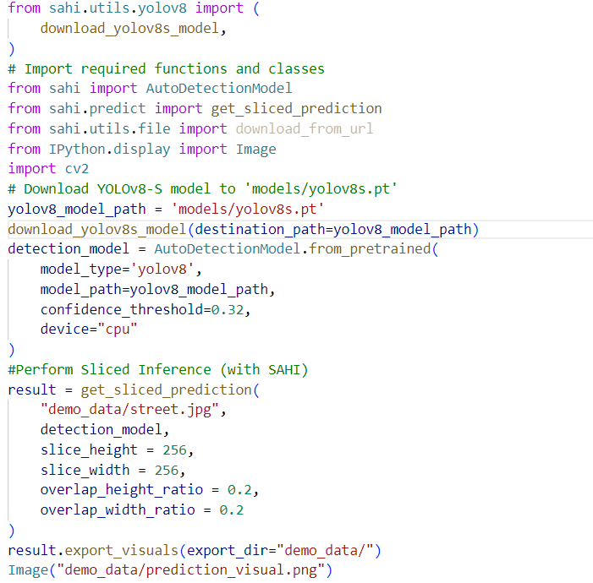

Slide 9
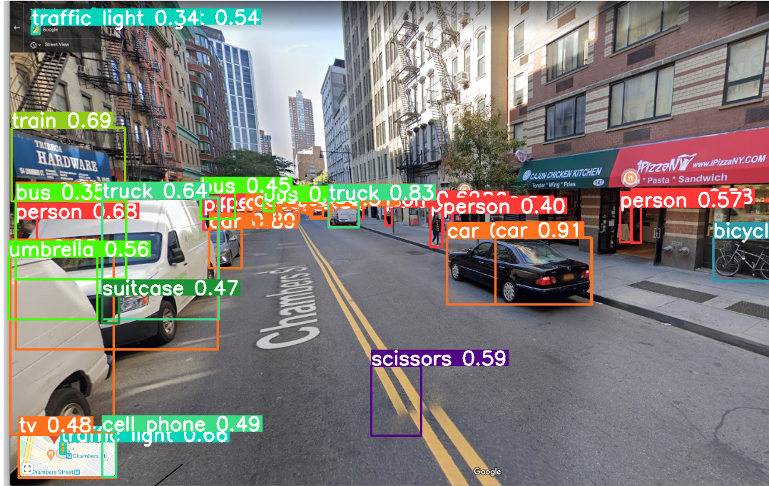
YOLOv8 Image YOLOv8+SAHI Image

Slide 10
YOLOv8 + SAHI
implemented on Large Objects

Slide 11
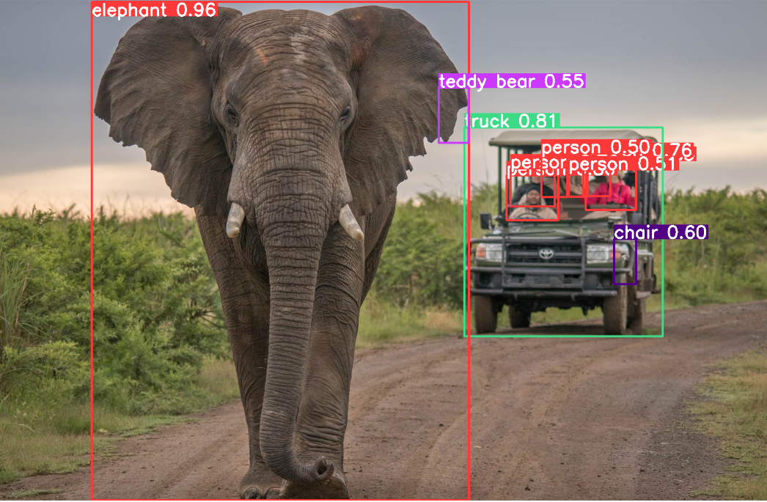
It's worth noting that YOLOv8 and Sahi are separate components, with YOLOv8 being the object detection algorithm and Sahi being the dataset. Utilizing YOLOv8 with the Sahi dataset can be a promising approach for addressing the specific task of detecting large objects.

Slide 12
Containerization
Dockerize the YOLOv8 + SAHI code

Slide 13
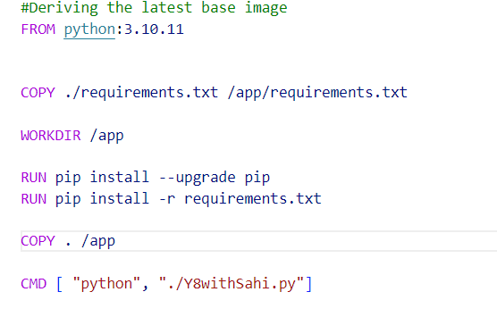
Steps to dockerize the project :
download and install Docker Desktop from the official Docker website (https://www.docker.com/products/docker-desktop).
2. Dockerfile: Create a Dockerfile in the root directory of your project. The Dockerfile contains instructions for building the Docker image.
To generate the requirements.txt file :
pip freeze > requirements.txt

Slide 14
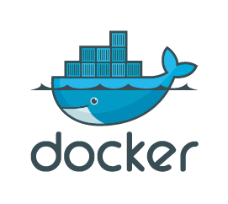
Steps to dockerize the project :
Build the Docker Image: Open a terminal or command prompt, navigate to the project's root directory (where the Dockerfile is located), and run the following command to build the Docker image:
docker build -t myproject:1.0 .
4. Run the Docker Container: Once the Docker image is built, you can run it in a container using the following command:
docker run myproject:1.0

Slide 15
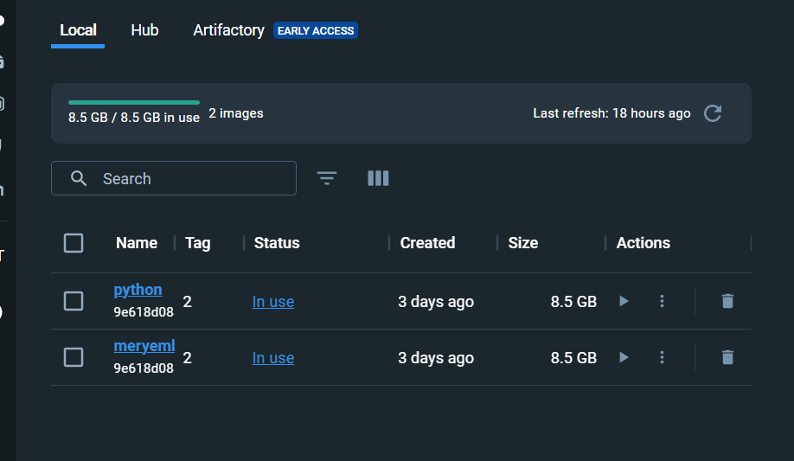

Slide 16
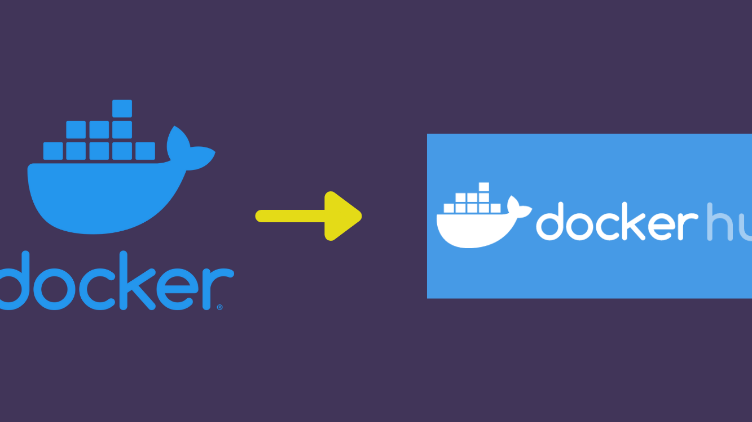
Docker Hub

Slide 17

To push your Docker image to Docker Hub:
Create a Docker Hub Account: If you don't have one already, sign up for an account on Docker Hub (https://hub.docker.com/).
2. Tag your Docker Image: Before pushing the image, you need to tag it with your Docker Hub username and the desired repository name.
docker tag python:2 meryembensalem/yolov8_sahi:2
3.Login to Docker Hub :
docker login
4.Push Docker Image :
docker image push meryembensalem/python:2

Slide 18
YOLO-NAS
1. What’s New ?

Slide 19
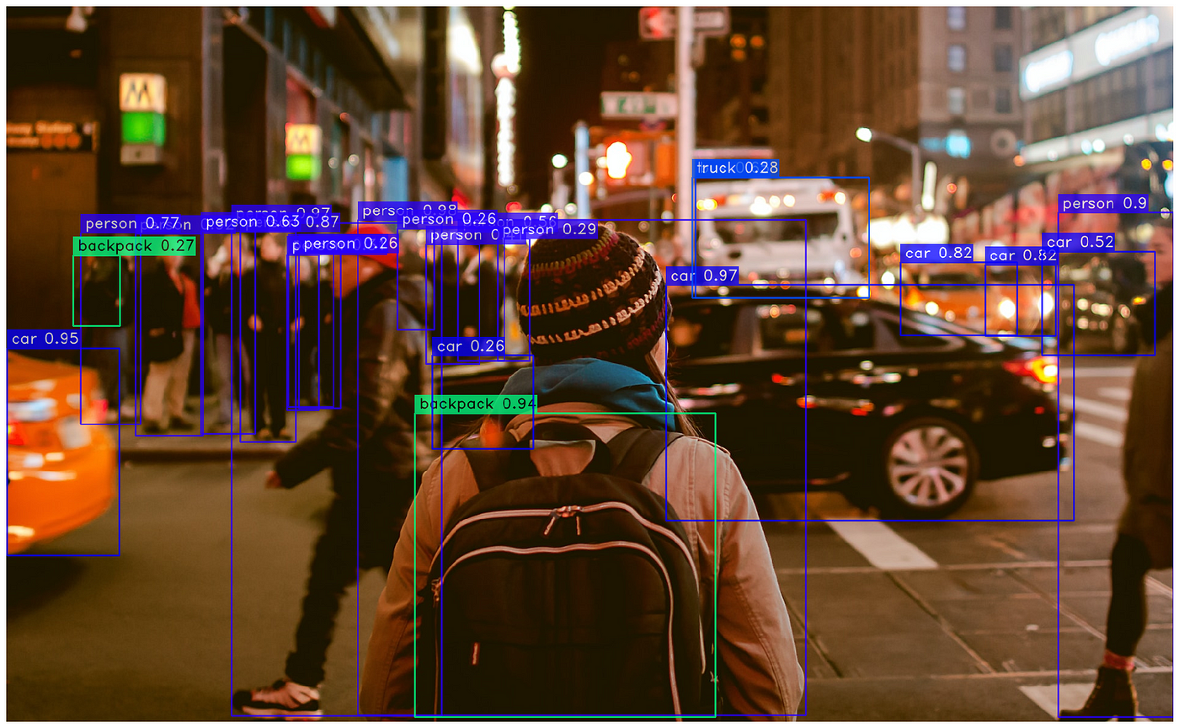
- Developed by Deci AI
- YOLO-NAS is the product of advanced Neural Architecture Search technology
- Meticulously designed to address the limitations of previous YOLO models
- Significant improvements in quantization support and accuracy-latency trade-offs
- YOLO-NAS represents a major leap in object detection

Slide 20
YOLO-NAS
2.What is NAS :a makeover for a trained deep learning model

Slide 21
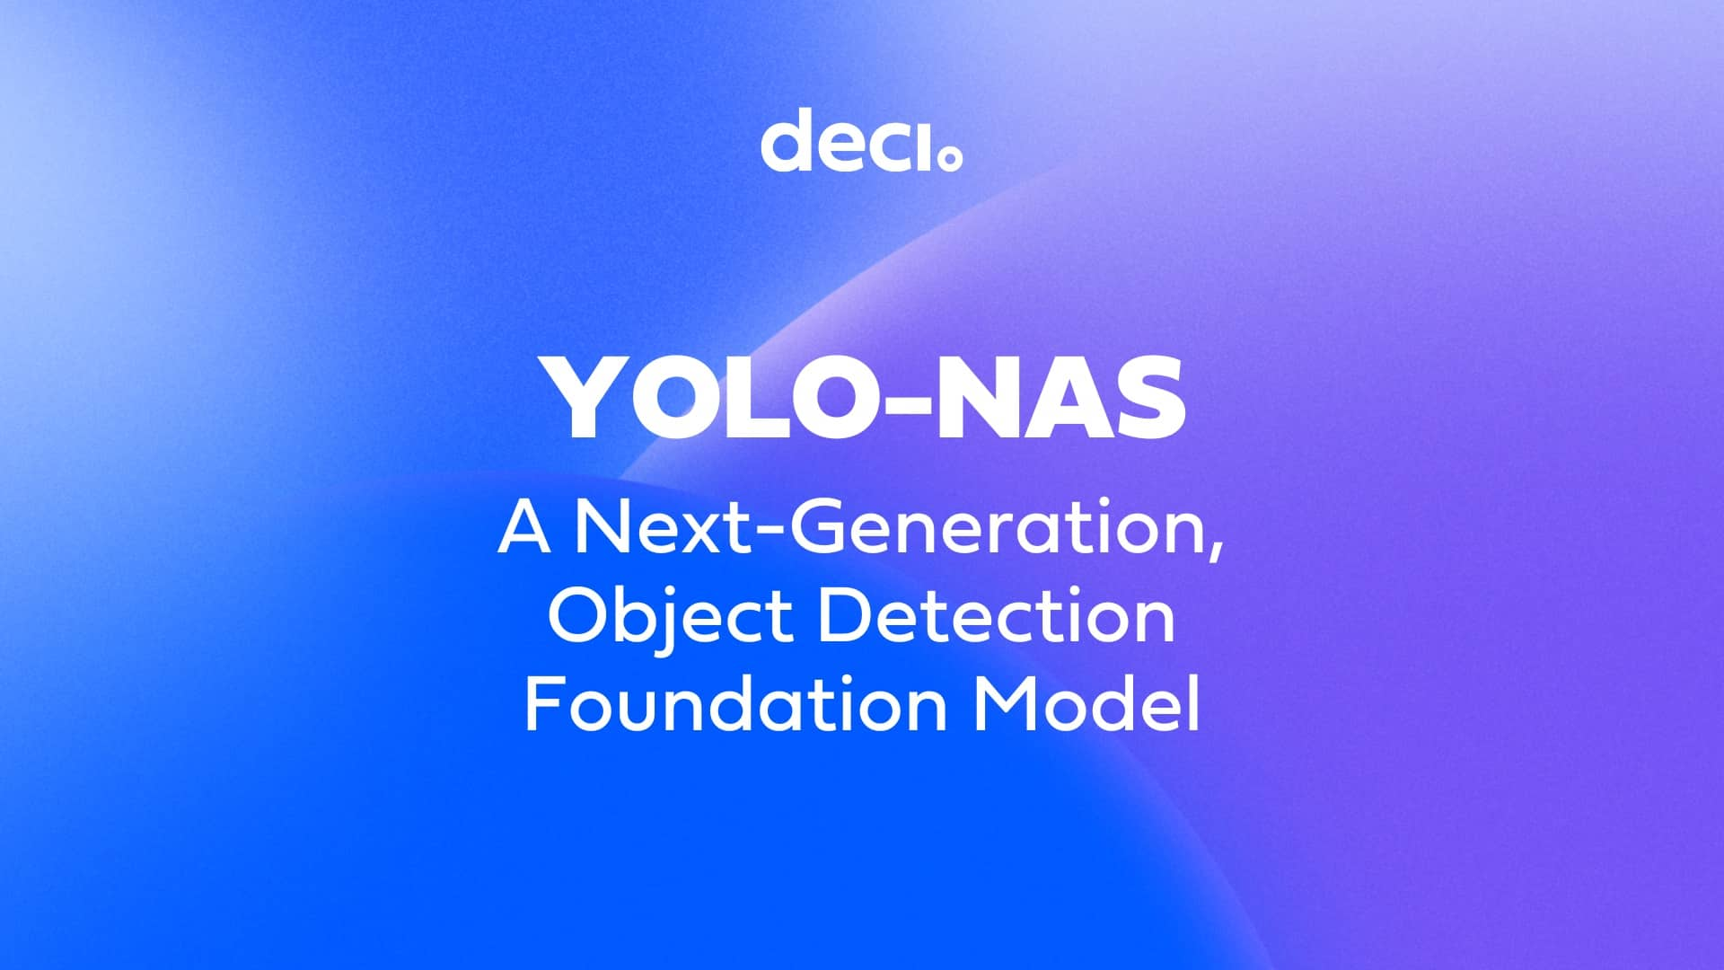
NAS automatically re-designs the model's architecture for performance enhancement.
It focuses on improving speed, memory usage, and throughput.
NAS involves defining a search space of architectural choices.
Architectural choices include layer numbers, types, kernel sizes, and connectivity patterns.
A search algorithm evaluates different architectures through training and evaluation.
The algorithm iteratively explores and refines the architecture space.
The goal is to find the architecture that yields the best performance.

Slide 22
Deci utilizes its proprietary AutoNAC technology (Automated Neural Architecture Construction ) for NAS in model architecture optimization.
AutoNAC optimizes the architecture for maximum inference performance on specific hardware while maintaining accuracy.
The new YOLO member incorporates quantization as another significant improvement.
Quantization converts weights, biases, and activations from floating point to integer values (INT-8).
Quantization enhances model efficiency by reducing memory usage and computational requirements.

Slide 23
YOLO-NAS
3. Key Features

Slide 24
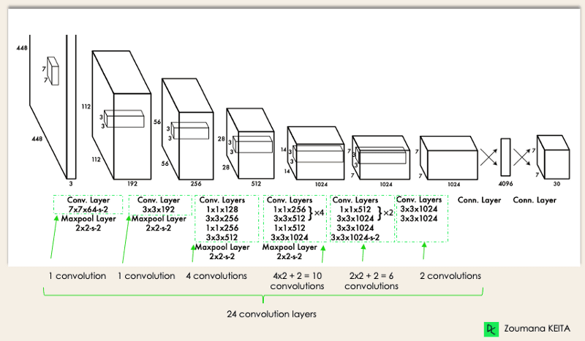
Quantization-Friendly Basic Block: YOLO-NAS introduces a new basic block that is friendly to quantization, addressing one of the significant limitations of previous YOLO models.
Sophisticated Training and Quantization: YOLO-NAS leverages advanced training schemes and post-training quantization to enhance performance.
AutoNAC Optimization and Pre-training: YOLO-NAS utilizes AutoNAC optimization and is pre-trained on prominent datasets such as COCO, Objects365, and Roboflow 100. This pre-training makes it extremely suitable for downstream object detection tasks in production environments.

Slide 25
YOLO-NAS
4. Results

Slide 26
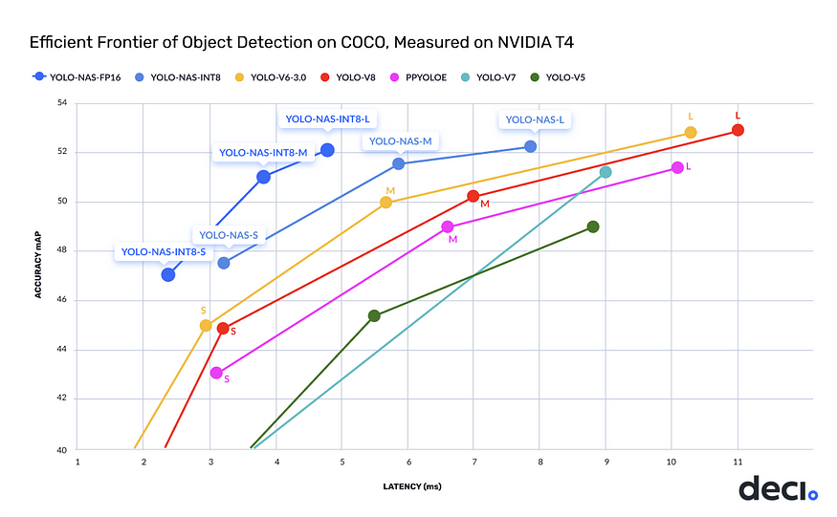

Slide 27
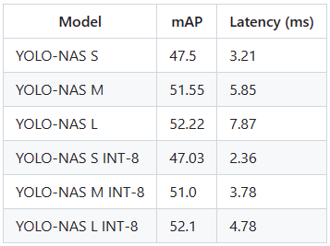
Quantized versions exhibit a slight drop in precision.
Novel quantization-friendly blocks and selective quantization minimize the precision drop.
The benefits of YOLO-NAS, such as improved inference latency, outweigh the downsides.
YOLO-NAS is pre-trained on COCO, Objects365, and Roboflow 100 datasets.
Pre-training on these datasets enhances its suitability for downstream object detection tasks.

Slide 28
YOLO-NAS
5. How to use it on images

Slide 29
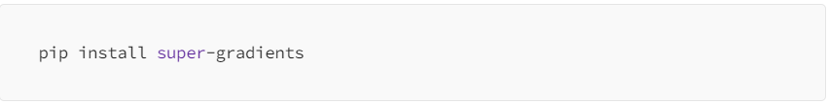
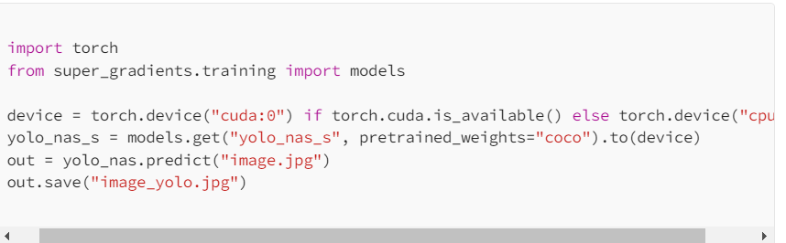
YOLO-NAS has been made available under an open source license with pre-trained weights available for research use on Deci’s PyTorch-based computer vision library called SuperGradients.
1) Install the super-gradients package :
2) Perform Inference :

Slide 30

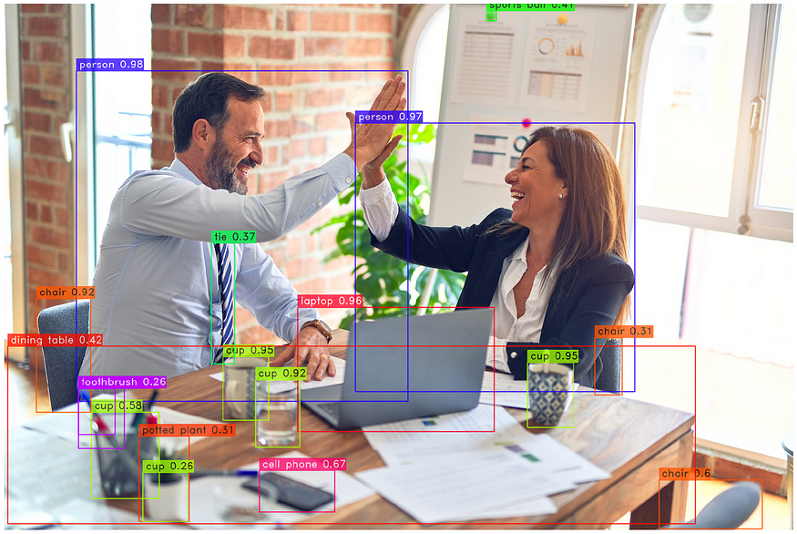
Input Image Output Image

Slide 31
YOLO-NAS
5. How to use it on videos

Slide 32
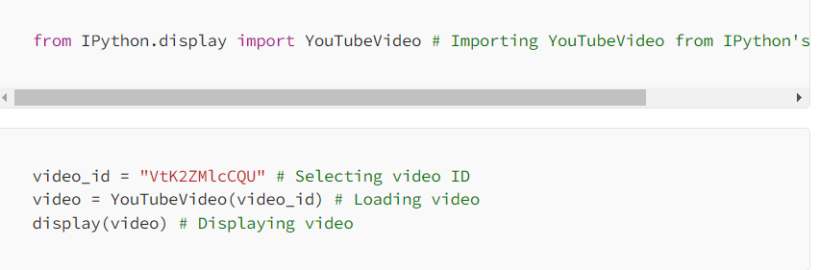
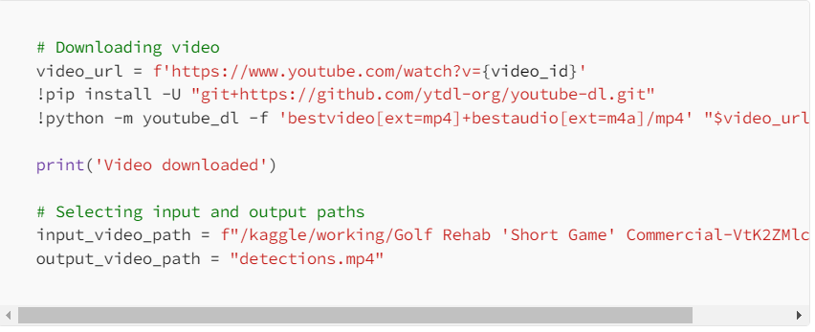
We can also use the YOLO-NAS model to perform object detection on videos

Slide 33
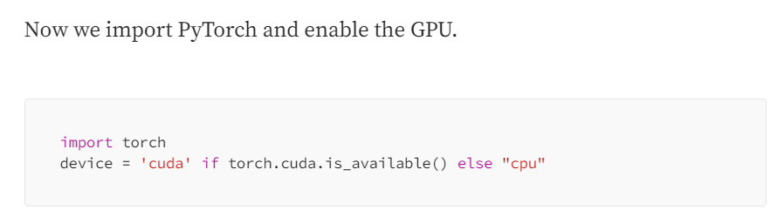
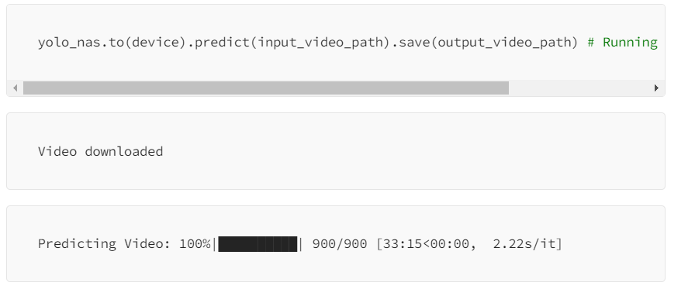

Slide 34
Does YOLO-NAS require OpenCV ?
YOLO-NAS is primarily concerned with optimizing the architecture of the object detection model, and it does not have a direct dependency on OpenCV.
However, when using YOLO-NAS in practice, you would typically use OpenCV or a similar library to handle image input/output and perform preprocessing tasks such as resizing, normalization, and color space conversion.

